Slide 1

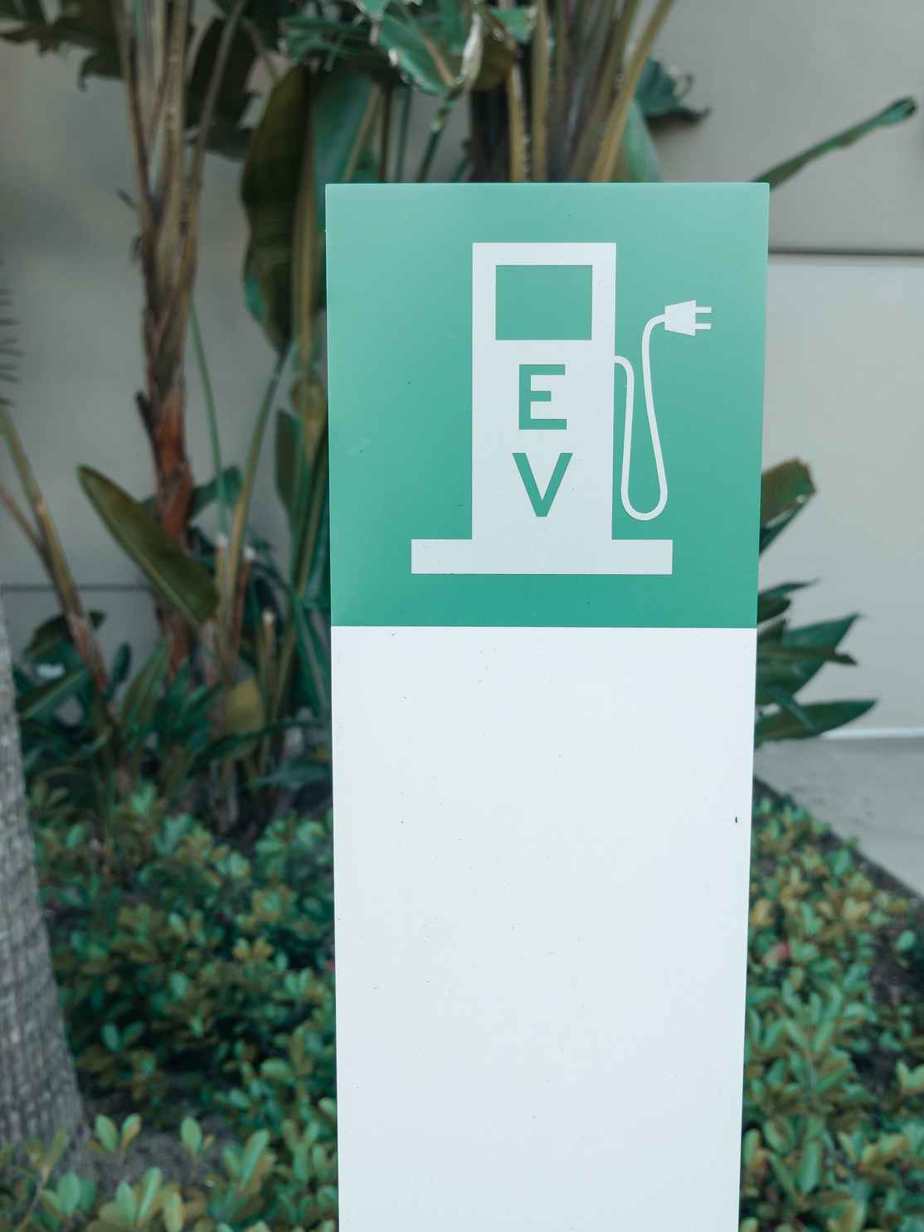

EV DATA
ANALYSIS &
VISUALIZATION
Use Case 1
by-Shray Ratan Gupta

Slide 2






Use Case 1:
Electric Vehicle (EV) Data Analysis and Visualization
Introduction
The EV Data Analytics Dashboard offers essential information on electric vehicle performance, such as range, speed, battery efficiency, and market share. Through the examination of data related to driving habits, charging durations, and environmental factors, this resource aids in maximizing vehicle effectiveness and improving user satisfaction. Delve into the dashboard to identify patterns and utilize data-driven insights to shape the future of electric transportation.
EV Cars
Why ?
Environmental Impact:
Reduces carbon emissions.
Promotes sustainable transportation.
Data-Driven Decisions:
Ensures long-term success and adoption of EVs.
Drives efficiency and innovation in electric mobility.
User Experience:
Understands driving patterns.
Improves charging behaviors.
Battery Optimization:
Enhances battery life.
Improves energy efficiency.

Slide 3





Key Findings and Metrics
Key Findings from the Research
EV Performance Metrics and Their Importance
Key Factors Affecting Battery Life and Energy Efficiency
Essential for assessing and enhancing vehicle efficiency and user experience.
Key metrics: energy consumption, battery life, charging times, driving range.
Energy Consumption
Battery Life
Charging Times
Driving Range
Temperature: Extreme temperatures degrade performance and efficiency.
Driving Habits: Aggressive driving increases energy consumption and battery degradation.

Slide 4


Insights & Recommendations
Visualization:
Interactive Dashboards: Creating visualizations using Tableau, Power BI, Plotly, Dash.
Analytical Lifecycle
Data Analysis:
Exploratory Data Analysis (EDA): Identifying patterns and correlations.
Trend Analysis: Analyzing trends in energy efficiency and battery degradation.
Domain Understanding:
Research: Studying EV technology and factors affecting performance.
Impact Analysis: Understanding variables like driving range and user behavior.
Data Preprocessing:
Cleaning: Handling missing values and outliers.
Normalization: Scaling numerical data.
Encoding: Converting categorical variables.
Data Collection:
Sources: Onboard sensors, charging stations, vehicle management systems.
Parameters: Battery status, energy consumption, driving patterns, charging history, environmental conditions.

Slide 5





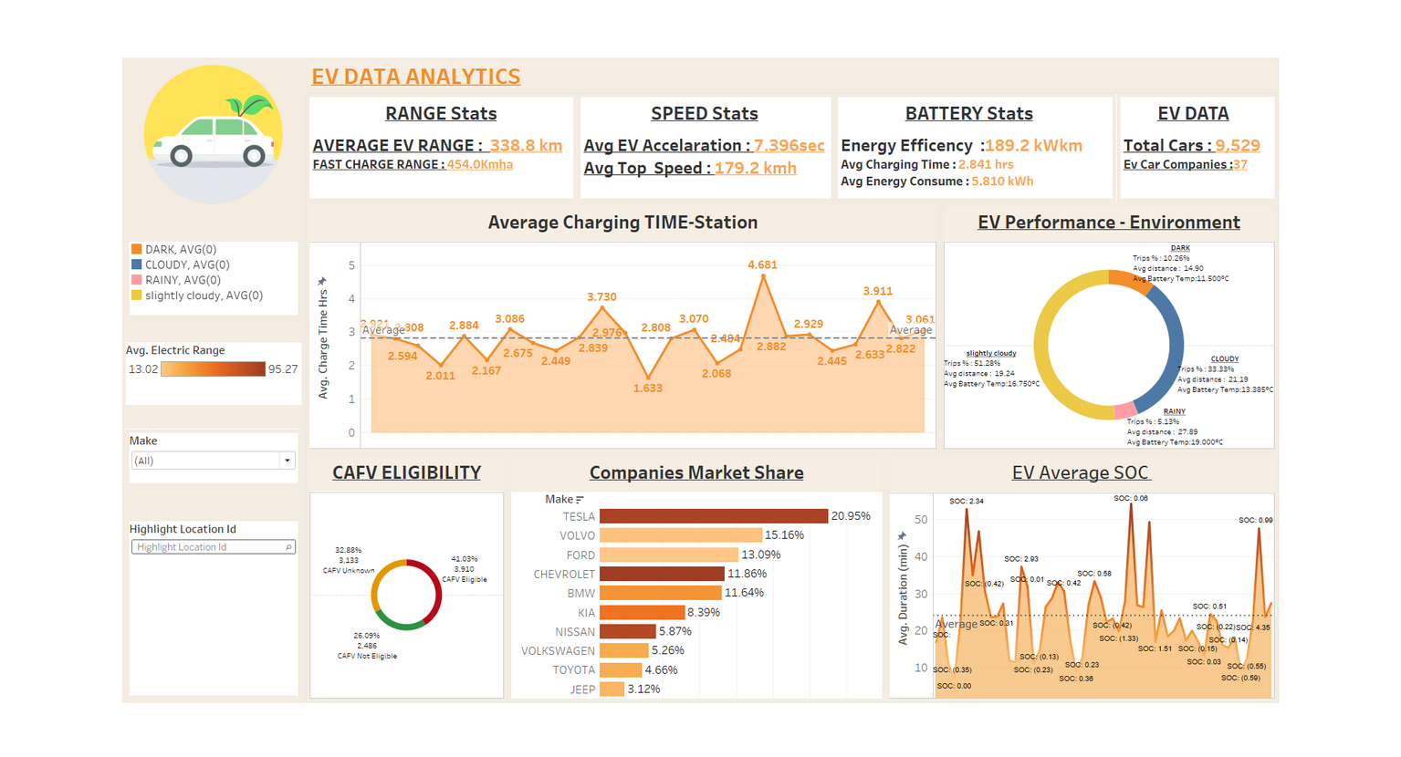
Visualisation:
01 Patterns in Energy Consumption:
Energy Efficiency: 189.2 kWh/km
Average Energy Consumption: 5.810 kWh per trip
02 Trends in Battery Degradation
Factors affecting battery life: charging practices, environmental conditions
Average charging time: 2.841 hours
03 User Driving Habits and Their Impact on Performance:
Average EV Acceleration: 7.396 seconds
Average top speed: 179.2 km/h
Impact of weather conditions on driving distance and battery temperature
04 Average Charging Time (by Station):
Average charging time: 2.822 hours
Insight: Charging infrastructure efficiency varies, suggesting the need for standardization and potential upgrades
05 EV Performance :
Distribution of trips under different weather conditions
Insight: Weather conditions impact battery temperature and trip distance, with notable effects in rainy conditions

Slide 6
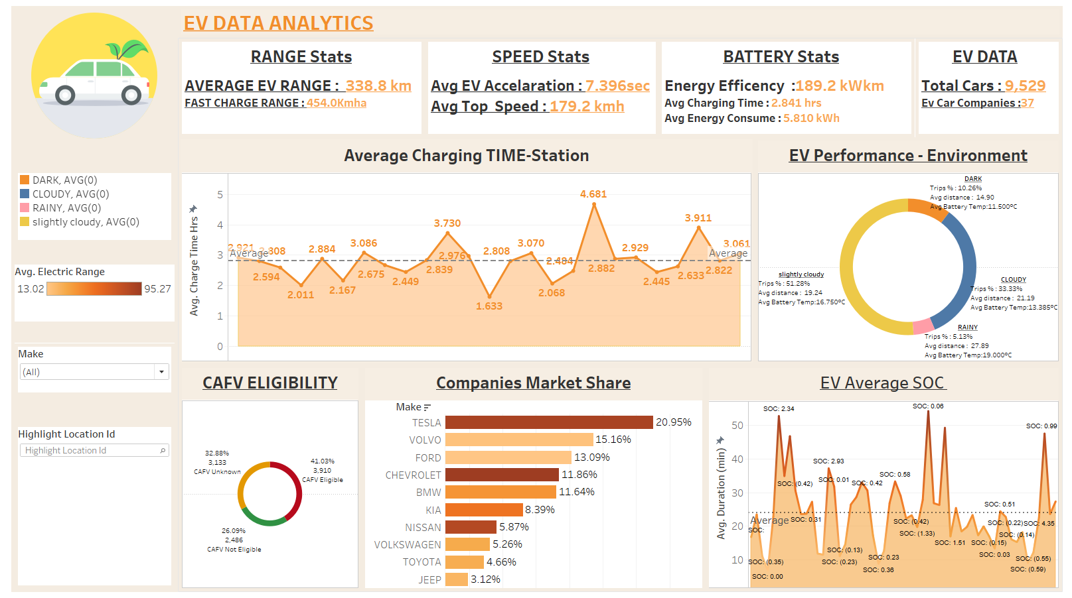
DASHBOARD:

Slide 7
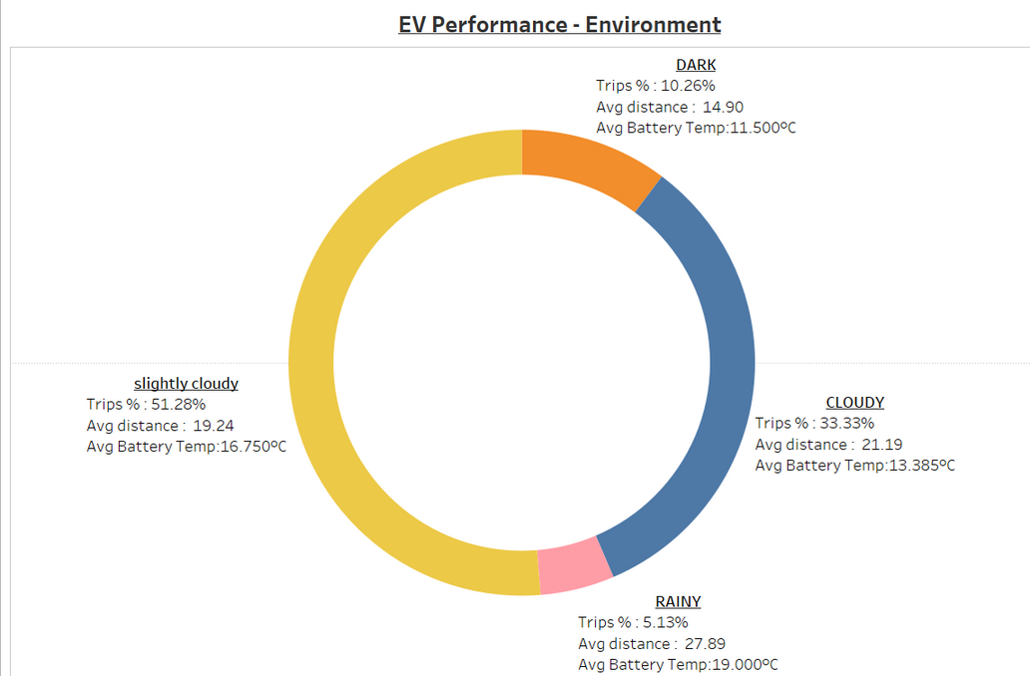
Recommendations :
Increase the number of fast-charging stations to decrease average charging times.
Develop strategies to manage battery temperature in varying weather conditions to maintain performance and longevity.
Focus on technologies that can reduce energy consumption per kilometer.
Companies with lower market shares should invest in marketing and product enhancements to compete with leaders like Tesla.
Educate users on best driving and charging practices to maximize range and battery health.

Slide 8


Potential Benefits
Energy Efficiency: Reduced energy consumption and improved efficiency.
Battery Life: Extended battery longevity through better management.
User Experience: Enhanced experience with personalized insights.
Charging Infrastructure: Optimization of charging station placement.
Operational Costs: Reduced costs for fleet operators and EV owners.
Sustainability Goals: Contribution to environmental sustainability.
Innovation :Driving innovation in EV technology and infrastructure.

Slide 9

Link and Documents :
Data Sources:
https://www.kaggle.com/datasets/kkhandekar/quickest-electric-cars-ev-database
https://www.kaggle.com/datasets/michaelbryantds/electric-vehicle-charging-dataset
https://www.kaggle.com/datasets/fatihilhan/electric-vehicle-specifications-and-prices
https://www.kaggle.com/datasets/gunapro/electric-vehicle-population-data
https://www.kaggle.com/datasets/kkhandekar/quickest-electric-cars-ev-database
Github : https://github.com/Shray-R-Gupta/Ev-data-analysis.git

Slide 10






THANK YOU
Shray Ratan Gupta
+91 7078662411
shray19ratan@gmail.com
Linkedin
Noida

